Slide 1
Data Fellowship Module 3
Tools of the Trade

Slide 2
Warm Up Activity
Notes:
Coach can add their own in

Slide 3
Session Outline...
Day 1 Understanding Big Data Using Big Data Advantages and Disadvantages Data Platforms Platforms vs Coding | Day 2 Features of R Exploratory Data Analysis in R Visualisation in R Linear Modelling in R RStudio
...and then you are done!

Slide 4
Learning Objectives
Understand fundamental concepts of Big Data
Justify the use (or lack of) Big Data technologies in your analysis
Critically evaluate the differences between using a platform and coding yourself Understand how R can be utilised in your analysis
Notes:
To be added

Slide 5
Understanding Big Data
Notes:
The aim of today is to show what big data is, why it is important to both you and your organisation.

Slide 6
Big Data
What is Big Data?
Notes:
Ask apprentices to annotate screen with their answers to the following questions:
What does ‘big data’ mean?
How would you use it in a working environment?
What type of data do we mean by ‘big data’?
Does your organisation have a stated Big Data strategy?

Slide 7
Big Data
Big Data is data whose scale, distribution, diversity, and / or timeliness require the use of new technical architectures and analytics to enable insights that unlock new sources of business value.
McKinsey & Co.; Big Data: The Next Frontier for Innovation, Competition, and Productivity.
Notes:
McKinsey’s definition of Big Data implies that organisations will need new data architectures, new tools, methods and an integration of multiple skills into the new role of a data scientist.
Data is created constantly and at an ever-increasing rate. Mobile phones, social media, imaging technologies- all these and more create new data and that must be stored somewhere.
Merely keeping up with this huge influx of data is difficult, but what is even more challenging is analysing the vast amounts of it, especially when it does not conform to traditional notions of data structure. This makes identifying meaningful patterns and extracting useful information harder.

Slide 8
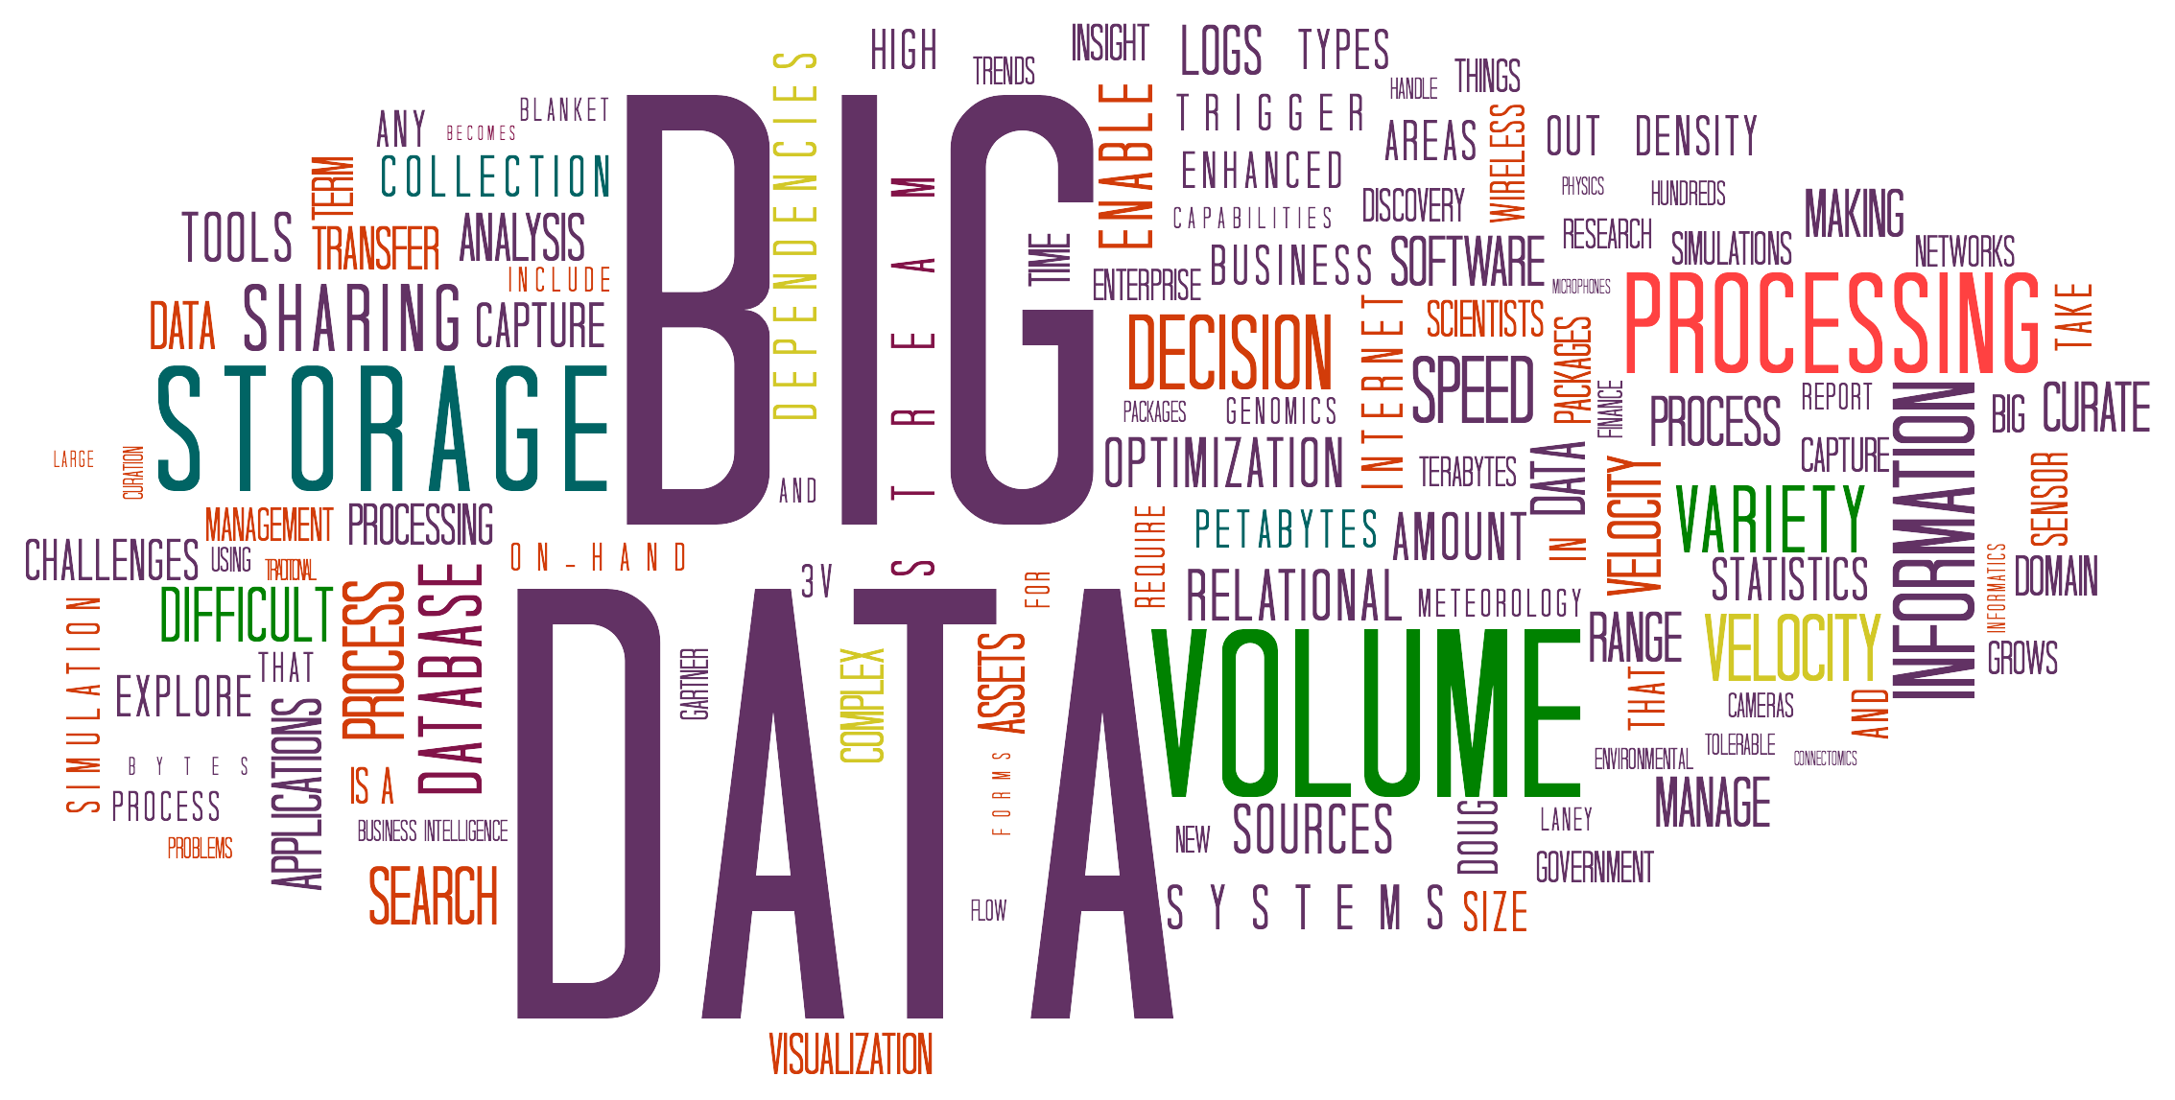
Big Data
Notes:
‘Big Data’ is data but in huge volume, but also growing exponentially with time. Like the way the universe is continually expanding there is no (real) limit to how large a ‘big data’ set can be. Except from storage…
There is no standard definition of how large a data set must be for it to be defined as ‘big data’, but typically it is so voluminous that traditional data processing software (tableau, excel, your laptop) can’t manage it. Such data is so large and compelx that none of the traditional data management tools are able to store or process it efficiently.

Slide 9

Generates 4 petabytes of user data every day

Slide 10
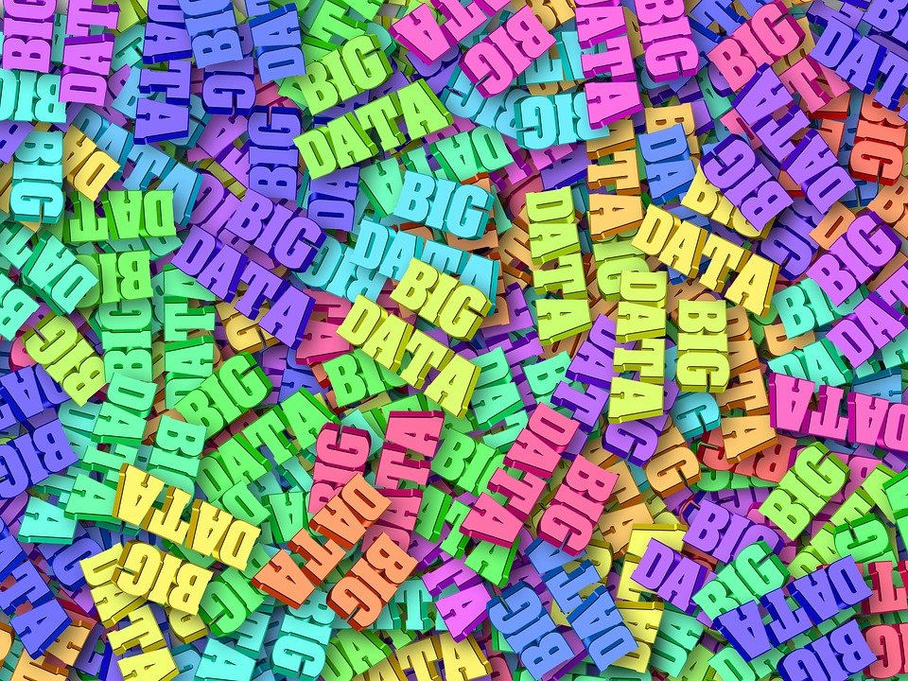
Big Data
Notes:
Therefore, Big Data as a topic is not only about the size and scope of the data, but the technology that supports it. Until recently, analysing big data sets was impossible- the tools literally hadn’t been invented! This is where software like Hadoop comes in, which we will be learning about today.

Slide 11

Big Data
Generates 500 million Tweets every day
Source: Internet Live Stats
Notes:
Let’s take 3 examples, Twitter, NY Stock Exchange and Facebook.

Slide 12

Big Data
Generates 1 TeraByte of trading data every day
Source: New York Stock Exchange

Slide 13
Big Data
Generates 4 petabytes of user data every day
Source: Facebook
Notes:
Each of them generates an enormous amount of data every minute of the day. These examples show not just the size of the big data but the continuous growth of data that it represents.
Ask the class- What other kinds of data sources can you think of that generates data at this scale? [Could day email (est. 168 million per second), sms messages (est 11 million per second) or google search results (est 698445 per second) for example).
Current estimates are that 1820 TB of new data are created every second over the planet.

Slide 14
Big Data
79% of enterprise executives agree that companies that do not embrace Big Data will lose their competitive position and could face extinction
Source: Accenture
Notes:
As Data Analysts it’s important we are able to properly explain what Big Data means (not only because it will be in your exam…). Particularly because there are big opportunities for those companies that embrace these newtools, analytical methods and data architectures.
Why should we care? As data analysts we have a lot more data sets to use to inform decisions in our companies. This shouldn’t be surprising, think about all the devices in our homes today that gather data (Alexa, FitBit, CCTV, etc that produce 5 quintillion bytes of data daily worldwide).

Slide 15
The Five V’s
Notes:
We have covered the types of data we might come across, but when it comes to analysing the data we might be presented with there are five characteristics we need to be aware of.
For a data analysts it is important to understand the nature of a data set being considered for inclusion as part of the big data for an organisation.

Slide 16
The Five V’s
Volume
IT
Value
Velocity
Veracity
Variety
Notes:
The 5 v’s are volume, velocity, variety, veracity and value. Don’t worry about memorising these right now, we’ll go through each one in detail. The 5 V’s provide a useful toolbox of characteristics that can be deployed to assess each data set, determine any risks and create parameters for how to use the data. You should use the 5 V’s as a mental checklist to employ whenever you are given a big dataset to work with.

Slide 17

Volume
Notes:
Size of data plays a very crucial role in determining value you can get out of the data
Whether a particular data set can actually be considered as Big Data or not is dependent on the volume of the data
Typically petabytes (1000 terabytes) or exabytes (1000 petabytes) of data consisting of billions to trillions of records of millions of people- all from different sources (e.g. Web, social media, mobile data and so on)

Slide 18

Velocity
Notes:
Refers to the speed of generation of data
Velocity deals with the speed at which data flows in from sources like business processes, application logs, networks and social media sites, for example
The flow of data is massive and continuous
Increasingly companies are looking to stream analytics and data
The data has to be available at the right time to make appropriate business decisions. The more agile a business the more the need for streaming.

Slide 19

Variety
Notes:
What type of data is the data source?
Refers to heterogeneity (how different it is) of data sources and the nature of data, both structured and unstructured
Encapsulated by the data types we saw earlier

Slide 20

Veracity
Notes:
Veracity is the quality of being true or the habit of telling the truth
Veracity of sources is always challenging
Rule of thumb: never trust data as given
Enquire and ask about the data preparation. Has it been normalised already? Been subject to statistical manipulation (i.e. outliers removed)?
Where possible, you should always ask to look at the raw data
Determining veracity can be challenging to an organisations (politics and policies) as well as externally (determining authorship/ownership)

Slide 21

Value
Notes:
It's all well and good to have access to big data, but unless we can turn it into something valuable it is useless
Does it provide added value to your business?
Is the organisation working on big data achieving a high return on investment?
If working with Big Data is not adding to a businesses profits, it is useless.

Slide 22

Activity
Select a data set you are familiar with. Analyse that data set against the 5 V’s.
Volume
Velocity
Variety
Veracity
Value
Notes:
TA- breakout rooms (max 4, 10 minutes)
In your groups look for some datasets you are familiar with (could be from work if closed cohort, or something they used for bootcamp/hackathon/presentation) and analyse them against the 5 v’s.

Slide 23
Developing the Future
Notes:
Big Data as a subject area is still being invested in heavily and is at the forefront of some of the most recent developments in computing.
Social media and genetic sequencing are among the fastest growing sources of big data and examples of non traditional sources of data being used for analyses.
How do you think machine learning help diagnoses in medicine?

Slide 24
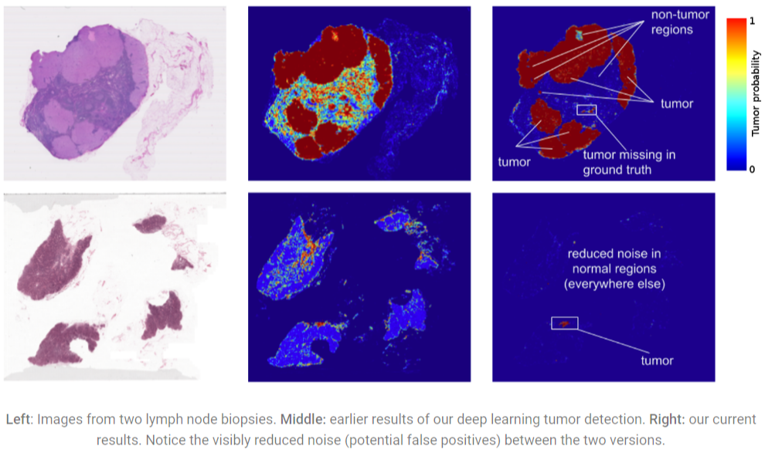
Medicine
Notes:
Genetic sequencing and human genome mapping provide a detailed understanding of genetic makeup and lineage. The healthcare industry is looking toward these advances to help predict which illnesses a person is likely to get in their lifetime and take steps to avoid these maladies or reduce their impact through the use of personalised medicine and treatment.
While data has grown, the cost to perform this work has fallen dramatically. The cost to sequence one human genome fell from $100m in 2001 to $10k in 2011. Today it costs around $1k.
Companies are able to leverage the vast amount of new data available to build machine learning tools to predict results based on past experience.
For example, a 2017 report showed it was possible to train a model to detect tumour in breast cancer patients that either matched or exceeded the performance of a pathologist who had unlimited time to examine the slides.

Slide 25
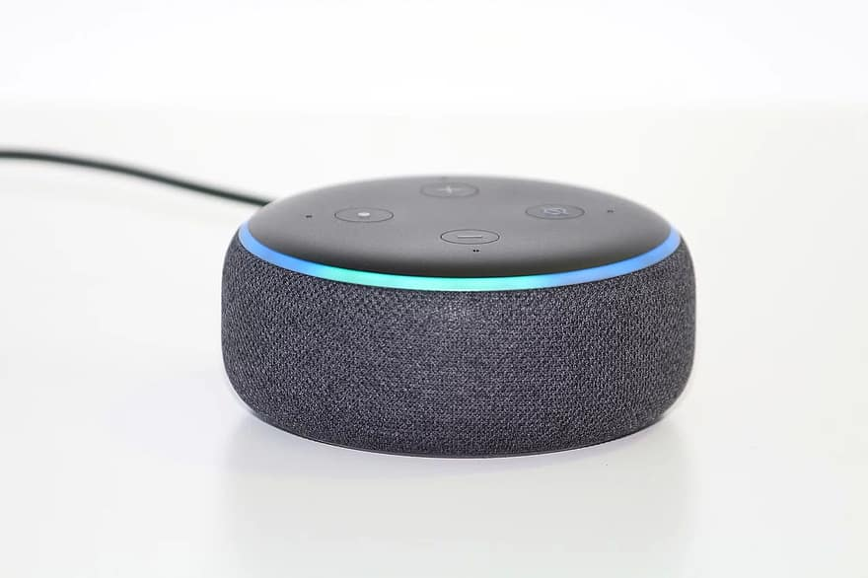
NLP
Read more about this story
Notes:
It is the ability of a computer to understand human language as spoken. The most obvious examples that people can relate to these days is Google Home and Amazon Alexa. Both use NLP and other technologies to give us a virtual assistant experience.
Activity- TA put apprentices in breakout rooms (4 for 10 minutes). In your groups discuss and sketch how you think Alexa produces personalised recommendations for you (e.g. music, restaurants, movies, etc)

Slide 26
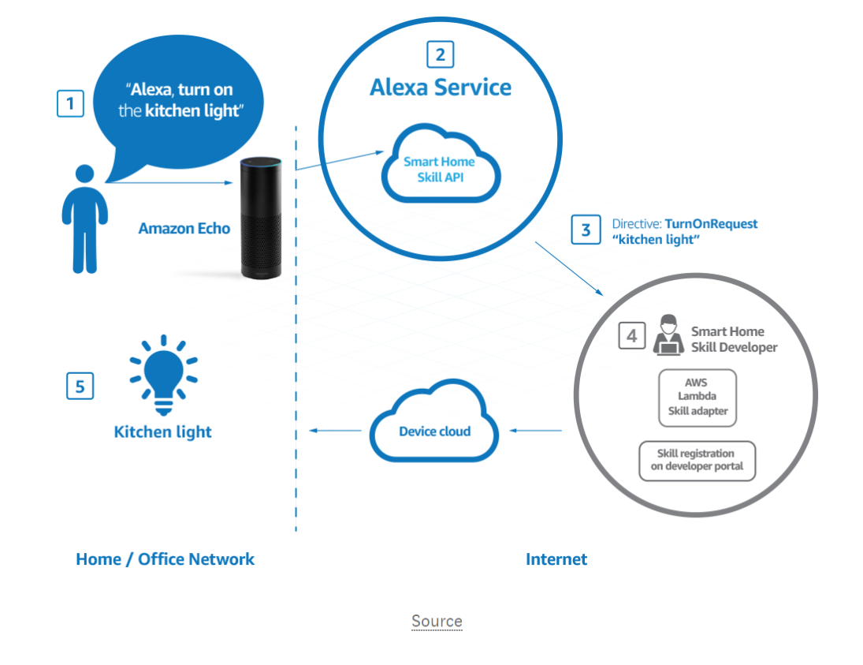

Alexa
Notes:
Alexa is built on natural language processing, a process of converting speech into words, sounds and ideas
Alexa will record your words. Interpreting sounds takes up a lot of computational power however, so the recording is sent to Amazon’s servers to be analysed more efficiently (use of big data)
There, the recording will be broken down into individual sounds. It then consults a database containing various word’s pronunciations to find which words most closely correspond to the combinations of individual sounds.
It then identifies important words to make sense of the tasks and carry out corresponding functions. For example, if Alexa ‘hears’ basketball, it would open a sports app
Amazon’s servers then send the information back to your device. Alexa may speak at this point. If Alexa needs to say something it will go through the same process, but in reverse (i.e. identify the words it wants to give, converts them into audio files and sends them back).
FOr the fun of it, I have included a video of Alexa in action…
What other uses of big data are you aware of?

Slide 27
How does it work?
Notes:
So how does Big Data work?
For the most part, it will run a SQL query, python script or some other piece of analysis that you could have run on your own local machine. Where Big Data comes in is the huge amount of processing it involves and instead of downloading all the data to your machine it instead takes your code to the data.

Slide 28


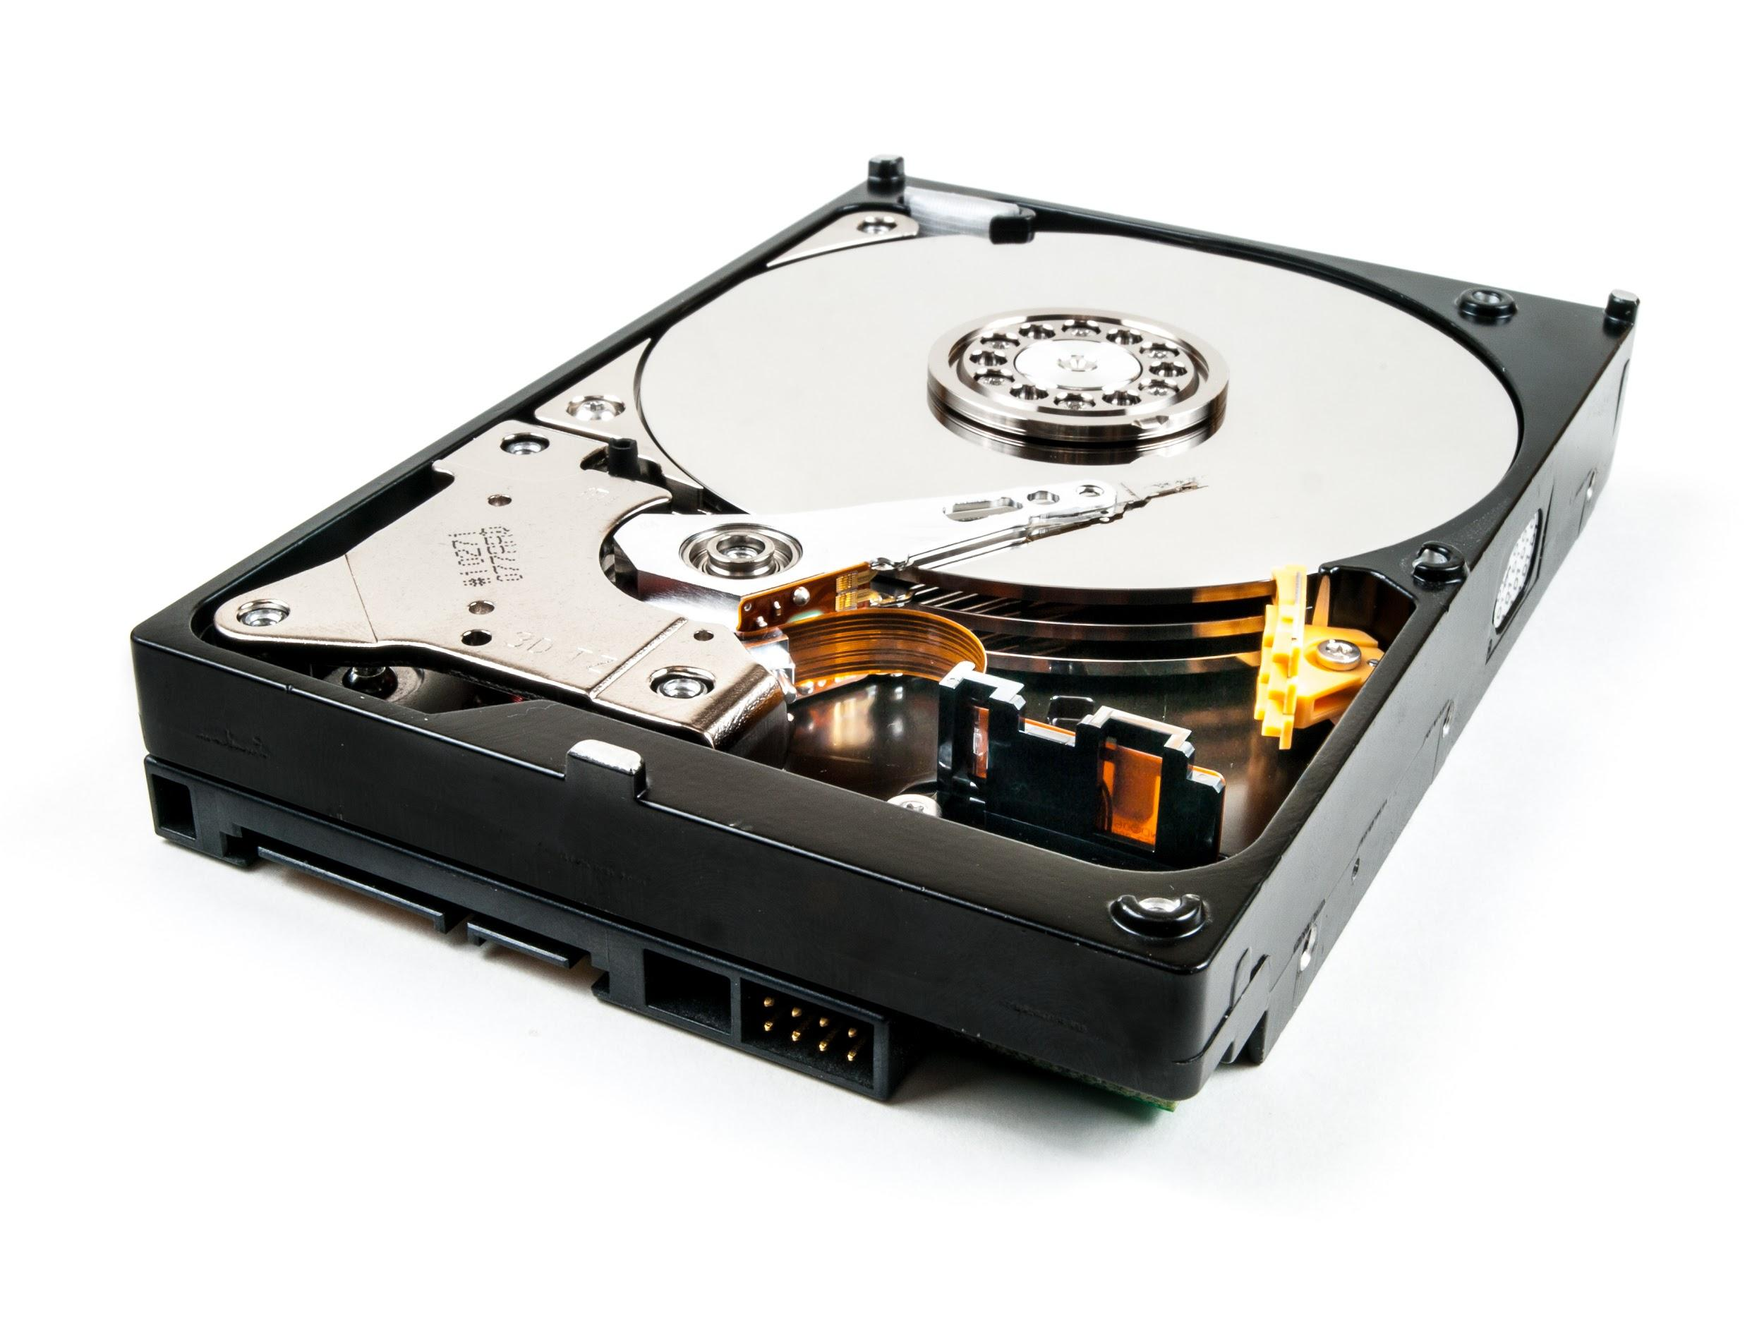
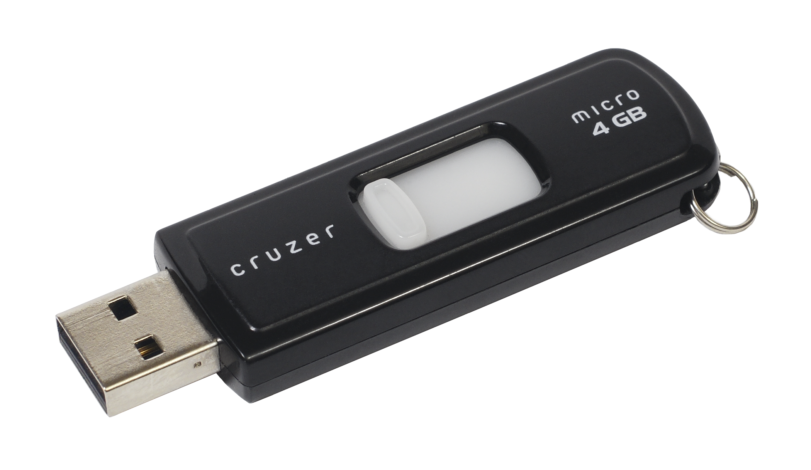
1 TB
@ 1000 MB per Second
A
One 2TB Intermediate Hard Drive
B
Ten 128GB USB Drives

Slide 29
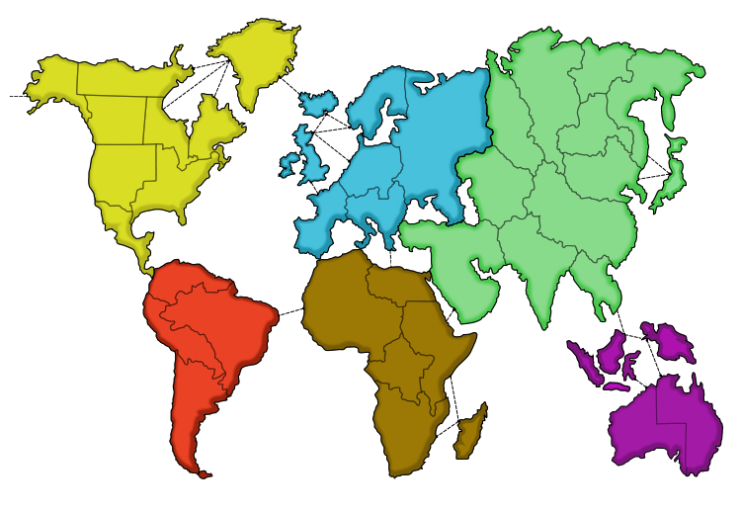
Divide and Conquer
Notes:
It uses an approach called ‘divide and conquer’ where the big data technology will split divide your data into smaller chunks and process each one simultaneously and then combine the results. To do this it will place these chunks over several servers (so that if one fails, the analysis can still continue and the remaining ones can pick up the slack).
Once complete, the results will be sent back to you.
Let’s do an example to show why it is quicker.

Slide 30
Divide and Conquer
1 TB
@ 1000 MB per Second
A
One 2TB Intermediate Hard Drive
B
Ten 128GB USB Drives
Notes:
Quick problem (breakout rooms ~ 5 minutes). Imagine you want to transfer 1TB (1000GB) of data between two computers. Assuming the transfer speed s 1000 MB per second, how long will it take to transfer the data using a) One 2TB intermediate hard-drive or b) Ten 128GB USB Flash Drives? Assume both computers have 10 USB ports and transferring into multiple USB drives simultaneously does not affect speed.

Slide 31
Divide and Conquer
1 TB = 1 000 000 MB
Moving 1000000 MB at 1000 MB per second takes:
1000 seconds (or 16.7 minutes)
Giving time for downloading to drive and uploading to computer, total time would be roughly 34 minutes
Dividing the file between each USB drive means each has to transfer 100 GB (or 100000 MB).
At 1000 MB per second this will take 100 seconds (or 1.7 minutes).
Given each drive is working simultaneously, downloading to drive and uploading to computer would take roughly 3.4 minutes
Notes:
This should demonstrate that splitting our Big Data into smaller chunks is a much faster and more efficient process.

Slide 32
Using Big Data in Your Role

Slide 33
Using Big Data
Notes:
Use the zoom annotate tool to write suggestions for how your business uses (or can use) big data to the best effect.
When writing up a project for your portfolio, a good thing to include is your justification (or lack of) big data technologies in your analysis. We will look into this in the following section.

Slide 34
Advantages (and Disadvantages)
Notes:
So what are the benefits of utilising big data in your analysis? When justifying your use or non use you will want to refer to some of the information provided in this section.

Slide 35
Advantages
Ability to access and process large quantities of data quickly
Analysis run on larger datasets will be more reliable, representative and accurate
Faster analysis leads to a reduction in human hours required saving money for the business
Projects finished in shorter time frames can lead to increased reputation amongst customers and products being brought to market.

Slide 36
Disadvantages
Big Data technologies only provide a small amount of free querying before they start charging and costs can rack up quickly
Therefore, you do not have time to play around or make mistakes- time literally is money
Using Big Data requires a degree of expertise from the user, you should not use it if you are not confident
The very nature of Big Data means you are exporting data externally from your company, this brings in cybersecurity risks and GDPR compliance
Your company will require the correct hardware (can be expensive) to run
It can be challenging to integrate Big Data output into your system
Notes:
In most cases the advantages of using Big Data will outweigh the disadvantages, but it is important to be aware of the downsides when writing up your portfolio.

Slide 37
Activity
In breakout rooms, read and discuss the following article:
https://www.datamation.com/big-data/big-data-pros-and-cons.html
Do you agree with what has been written?
Can you find other articles which support or argue against the use of big data technologies?
How do you think the use of big data will personally affect you in your role?
Notes:
In breakout rooms read and discuss the following article- https://www.datamation.com/big-data/big-data-pros-and-cons.html
Do you agree with what the writer has put? Can you find other articles which support or argue against the use of big data? What do you think and how can it personally affect your role?

Slide 38
Big Data Products
Notes:
Finally, let’s look at what Big Data products/technologies/software are available. We will not look into any of them individually, but it is important you know what exists if you want to try them out.

Slide 39



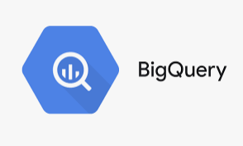

Products
Notes:
There are many platforms or services that allow for the efficient processing of Big Data. Hadoop was one of the first built and many companies still use it today to process their data. Apache Spark provides a similar service and both can be easily integrated with python.
BigQuery is run by Google while AWS is run by Amazon, both have a wide suite of functions allowing you to run queries and scripts efficiently. AWS even has functionality to bring python scripts live. Azure is owned by Microsoft and offers a cloud computing platform with a wide degree of functionality
Many more exist, what does your company use?

Slide 40
Data Platforms
Notes:
Now we have looked at Big Data let’s discuss another aspect of data analytics- using software. Most companies invest in software/platforms to make analysis quicker and easier, but are they better than doing it yourself? For example, we can produce a wide range of visualisations in tableau or we could code them ourselves with python- which is better?
Before we get into the discussion, let’s look at some of the common softwares you may come across

Slide 41


Common Platforms
Notes:
Already in this course we have come across tableau/PowerBI, softwares for producing visualisations (as well as other forms of analysis). Can anyone remind us of what some of the functions of these programmes were?
Wide suite of visualisation options, statistical inference (regression, clustering, time series, etc), string functions, aggregate functions, etc.,

Slide 42

Common Platforms
Notes:
Many of you are familiar with software like Microsoft Excel for spreadsheet and database management. It is easy to perform EDA, calculating aggregates and making visualisations as well as producing tables for showcasing your results. The GUI is fairly intuitive and macros allow for a great range of functionality including adding regression and other ML techniques)

Slide 43

Common Platforms
Notes:
Has anyone used SPSS before? SPSS stands for statistical package for social sciences and allows you to perform a wide variety of statistical operations on a dataset, including linear and logistic regression, ANOVAs and much more. It is expensive to license and has a steep learning curve, but once you are confident you can perform statistical calculations incredibly quickly through few clicks of a button.

Slide 44
Common Platforms
Notes:
What about software like Azure? Azure is a cloud based computing platform which allows you to perform analytics, storage, networking and is used to supplement companies servers (or even replace them).

Slide 45





Common Platforms
Notes:
There are also a wide range of platforms that help with EDA and predictive analysis such as Knime, Alteryx, Jira, Anaplan and more. Do any of you use other similar software?

Slide 46
Activity
In Breakout Rooms:
Discuss what software/platforms you use in your role
What are the advantages (and disadvantages) of using them?
Nominate someone to feedback to the rest of your group what you discussed
Notes:
In breakout rooms, discuss what softwares you use in your role and what advantages (and disadvantages are of using them). How do you think you can use them in your role?

Slide 47
Platforms vs Coding it Yourself
Notes:
So we have seen various platforms and softwares you can use in your role if your company has licensed them, but are they the best way forward? All platforms depend on pre-written code, but could it be better to just code it yourself? When writing your portfolio you need to be able to justify why you used (or didn’t use) certain programmes, and what can be good reflective evidence is a critical evaluation of coding yourself or using a platform. The following slides will list some of the advantages and disadvantages of each you can use in your write ups.

Slide 48
Advantages
Using Software
Coding Yourself
Easy to use and do not require technical coding knowledge or skills
More agile as ‘drag and drop’ options allow for quicker building of functions/models/visualisations
Greater agility leads to lower costs as less time is spent on development
Relatively simple to change your function/model/visualisations
Often tech support available
You get complete control over the whole building process and can customise colour schemes/functionality in almost any way imaginable
Data entry can be faster and more accurate
Common coding languages are free to install/use
You own the source code
Most languages have an active community you can ask for help
Notes:
First the advantages of using each. When using software you are using other people’s code with a visual interface meaning it is simpler to build what you want, without having to type all the code yourself. This means projects can be completed quickly reducing costs to your stakeholders and freeing up your time. COding it yourself however gives you complete control over the whole process and costs nothing in terms of licensing. You also own the code, meaning it is more secure and you hold intellectual property rights.

Slide 49
Disadvantages
Using Software
Coding Yourself
Can be a steep learning curve and training will be required for each different platform/software you use
While they incorporate a wide range of functions, options are still limited when compared to coding yourself
Security and reliability issues around you not having complete control over the code
If the product ceases to exist, it can be difficult to migrate your model/visualisation
Licenses are expensive
You do not own the source code
Learning to code is a daunting process
Coding is constantly evolving and the onus is on you to keep up with trends
Complicated codes take a long time to produce and require constant error checking and validation
Easy to make a mistake and sometimes difficult to find errors
Making small changes to large code scripts not always simple and can lead to unintended side effects
Code is harder to understand for non-technical colleagues when compared to platform outputs
Notes:
Now onto the disadvantages for each. While platforms can make building models quick and easy, you still need to learn how to use the programme and if your company licenses a new one then you will need to receive more training, as most programmes have unique methods of useage. On top of this, while platforms often contain a wide suite of processes they are still limited compared to what you can do yourself. A bigger issue also relates to data security- you are not in complete control of your code and data, if the platform provider is hacked your data potentially could be compromised and what happens if you want to switch provider or they go out of business? Migrating your properties across platforms can be difficult.
Coding yourself however does have its challenges too. Not everyone can code and with it being an ever changing process can be a daunting process to begin learning. Even seasoned coders can be unfamiliar with new concepts and reluctant to learn. Complicated models can take a long time to build and can also be frustrating- it can be difficult to identify where errors will occur as often they won’t appear until you’re ready to run the entire script. If it is a large script finding errors can be challenging, and minor changes could lead to serious unintended consequences later down the line.
Using a platform or coding it yourself is a decision you must make when completing a project and a decision you must justify in your portfolio. When writing up the task/action section write down what method you used to achieve your goal and give reasons for why you did and not any other method. This could be to prioritise stakeholder need as they require output in a particular way.

Slide 50
Activity
Mr Jones works in a data analytics department and has been given a project to complete. He must design a dashboard that displays daily KPIs for his stakeholders.
In teams you will be each be assigned a different product (Tableau, Python, etc) and will come up with arguments to convince Mr Jones to use your product.
Each team will then be given 1 minute to pitch their product.

Slide 51
Setting up R
Notes:
Before we finish this session let’s take some time to set up R which we will be looking at tomorrow.

Slide 52
Setting up R
Open Anaconda
Click Environments
Click Create
Name it R and check the R box
Wait a few minutes for the environment to be created
Once ready, click on the triangle next to R and select ‘Open with Jupyter Notebook’

Slide 53

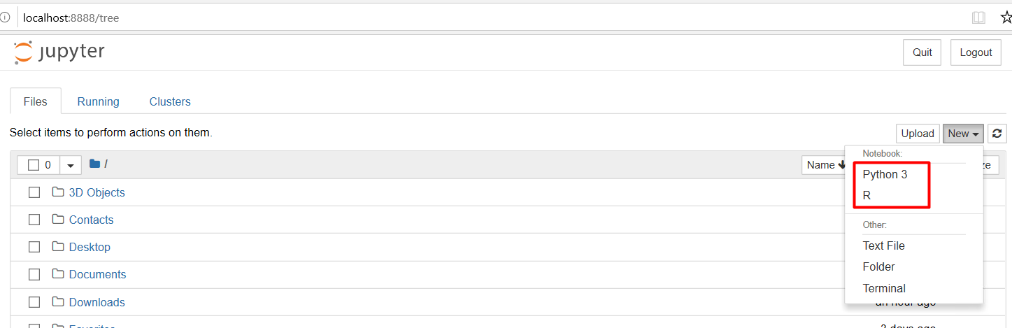
Notes:
To run R in Jupyter Notebook: click new then select R.

Slide 54
Quick recap

Slide 55
Learning Objectives
Understand concepts of Big Data including how it works and how it is used.
Justify the use (or lack of) Big Data technologies in your analysis
Critically evaluate the differences between using a platform and coding yourself Utilise R in your data analytics
Notes:
To be added

Slide 56
Assignment
Justify the use (or lack of) Big Data technologies in your analysis
Required:
Written Justification (max 1500 words)
Things to consider:
How does your company make use of big data technologies? Do you have opportunities to use them in your role? Do you think you could use these technologies effectively? Do you think your company uses them effectively? What is the business impact of your company’s attitude towards Big Data?

Slide 57
Session Attendance Log, 20% and Assignment!

